Slide 1

AMSTer : SAR & InSAR Automated Mass processing Software for Multidimensional Time series
Nicolas d’Oreye^{1,2}, Dominique Derauw^{3,4}, Sergey Samsonov⁵,
Delphine Smittarello¹, Maxime Jaspard¹, Gilles Celli¹
ndo@ecgs.lu
amster@ecgs.lu
1 European Centre for Geodynamics and Seismology (ECGS), 19 rue Josy Welter, L-7256 Walferdange, Luxembourg
2 National Museum of Natural History (NMNH), 19 rue Josy Welter, L-7256 Walferdange, Luxembourg
3 Centre Spatial de Liège (CSL), Avenue du Pré Aily, B-4031 Angleur, Belgium
4 SAREOS, 1 Rue des Violettes, 4557 Fraiture, Belgium
5 Canada Centre for Mapping and Earth Observation, Natural Resources Canada (NRCAN), 560 Rochester Street, Ottawa, ON K1A 0E4, Canada

Slide 2
Summer School in InSAR, time series processing and deformation modelling
MSBAS inversion:
Prepare the inversion, run the inversion, best parameters selection, additional pairs selection (coh, dates, phase closure).
Nicolas d’Oreye

Slide 3
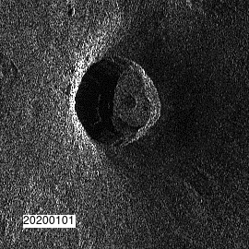

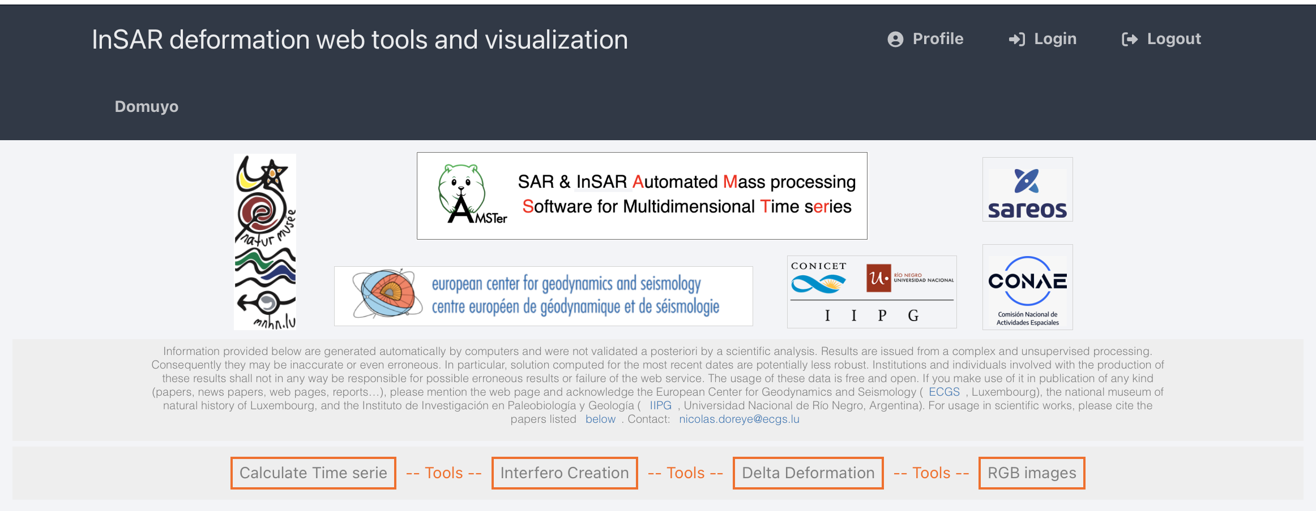
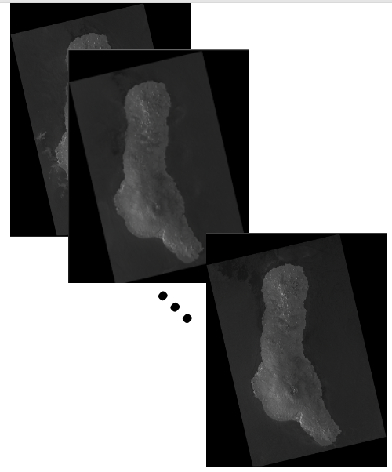
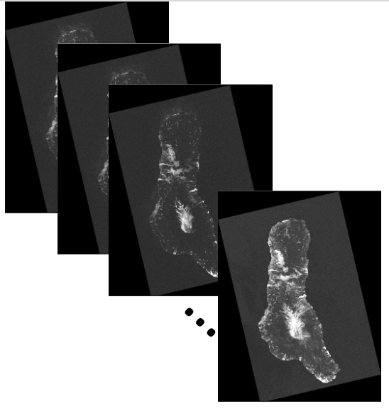
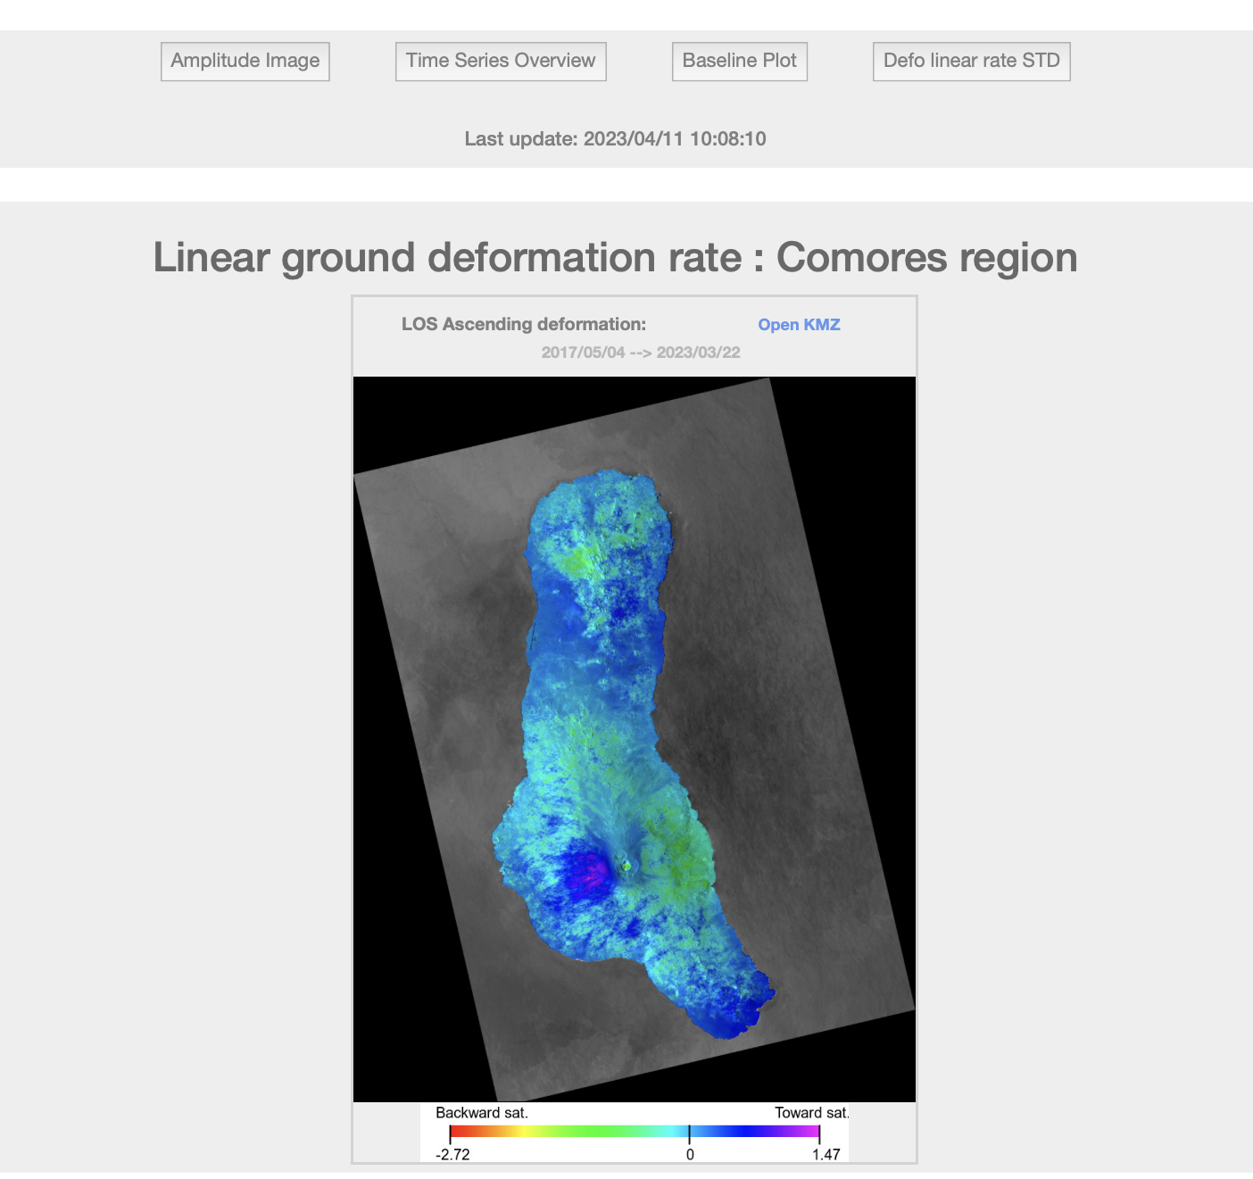
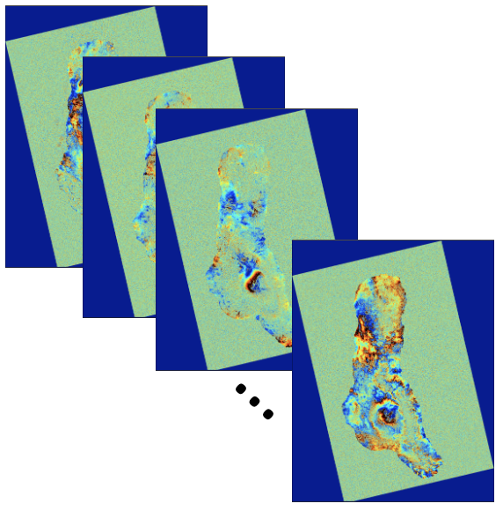
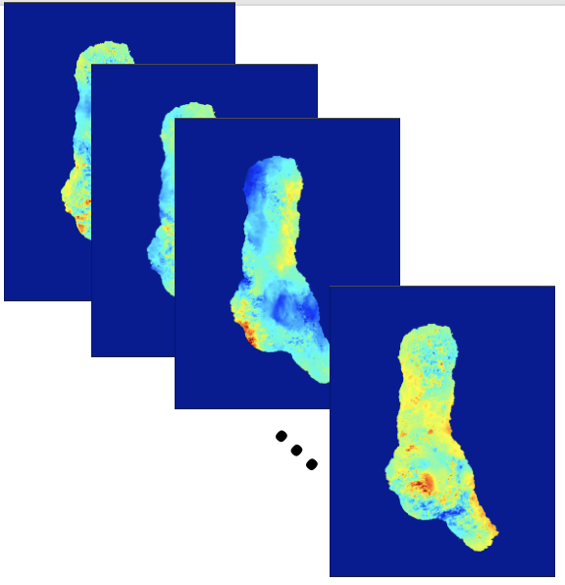
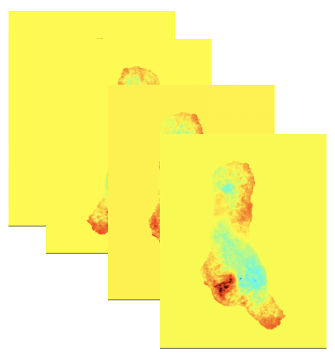
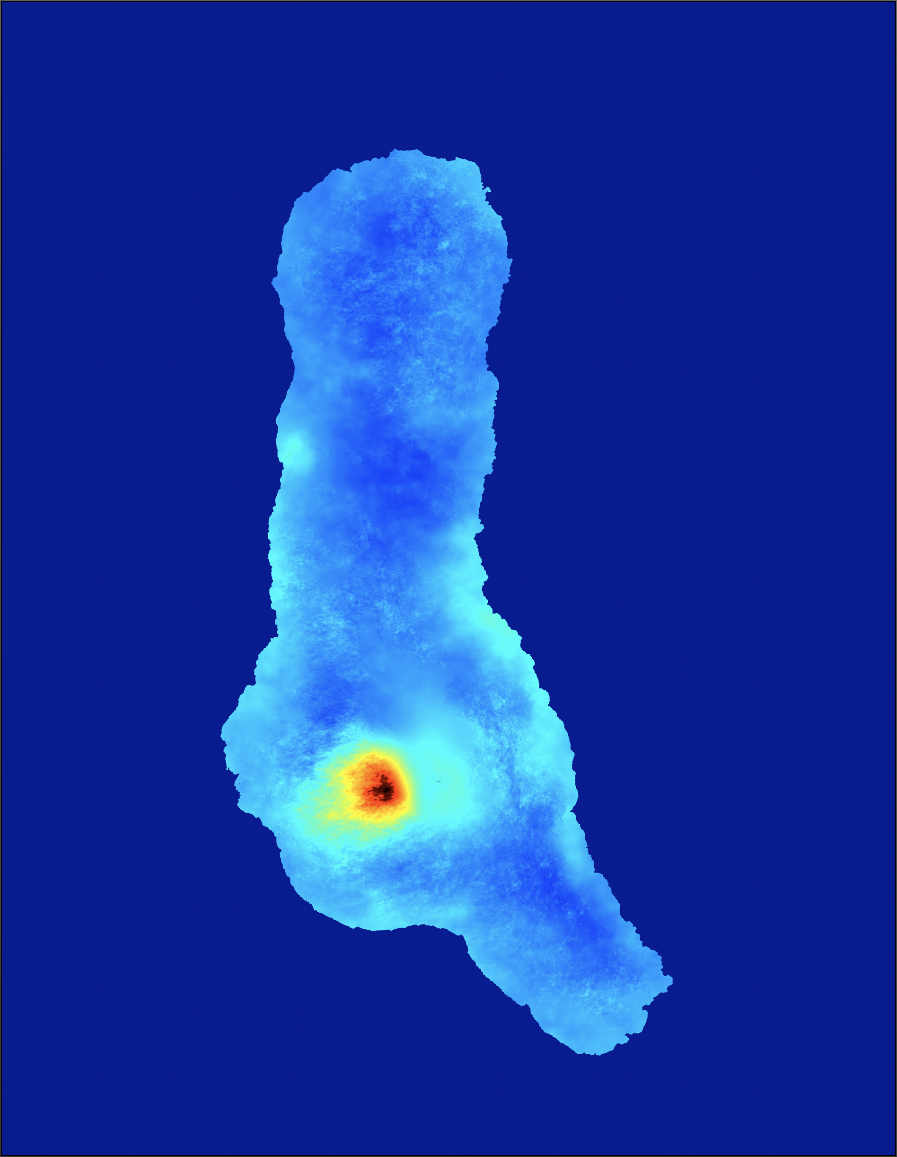
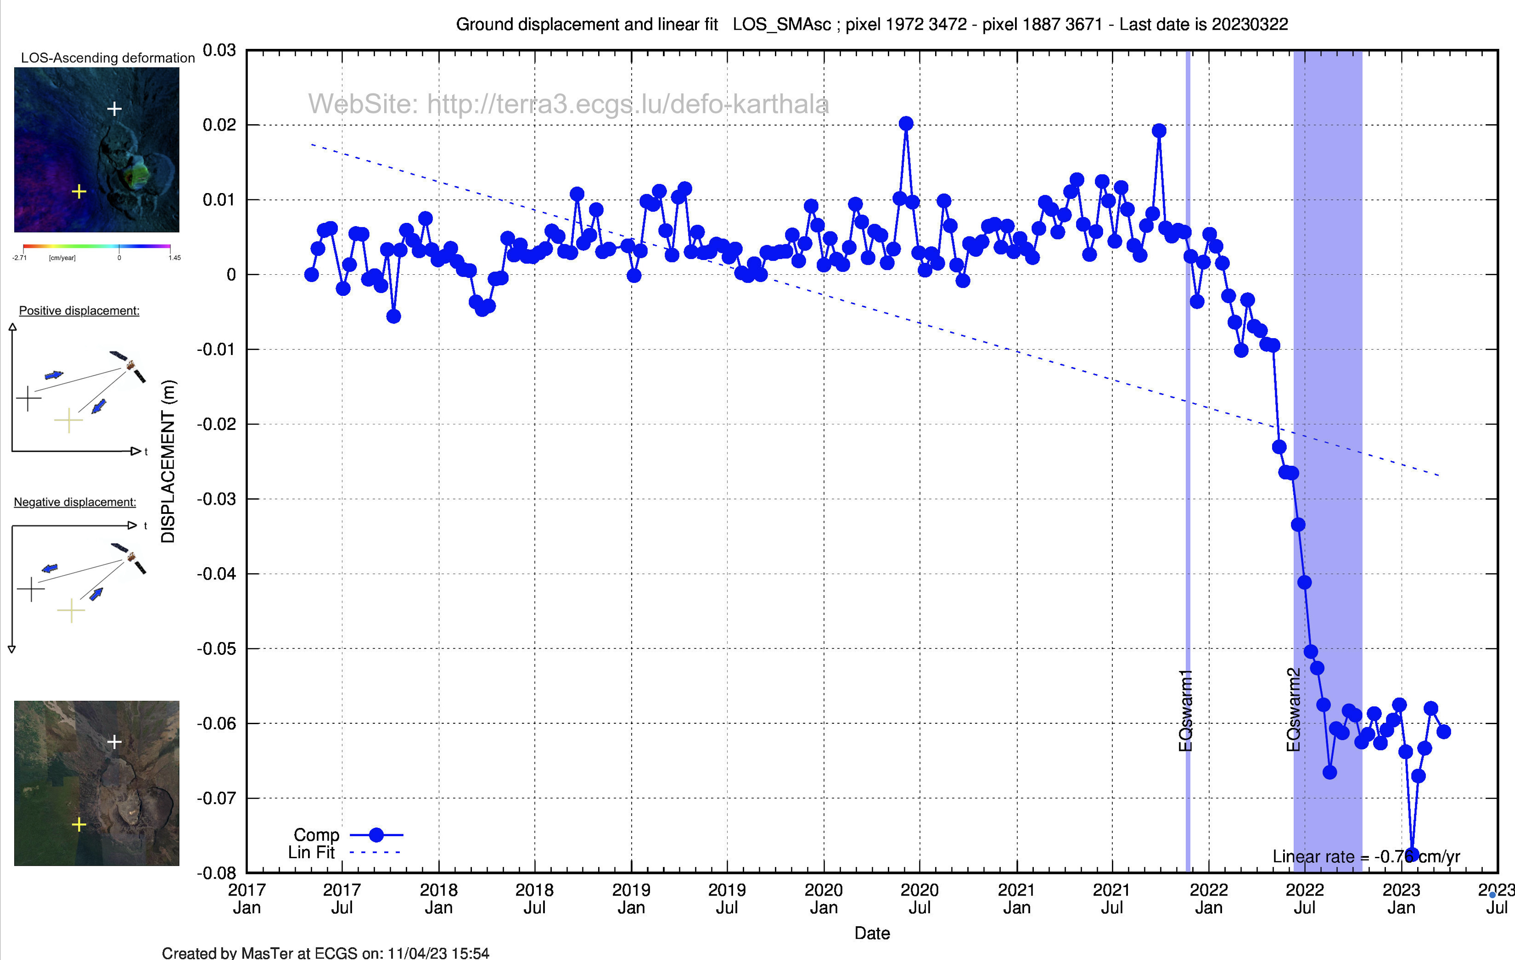
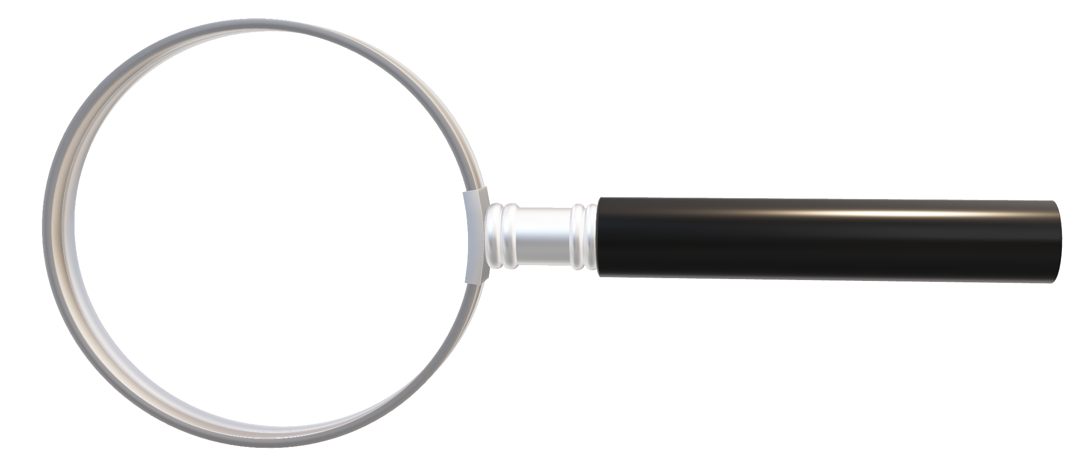
MasTer Toolbox
Sat. image
Download
Web Page(s)
Interferometric processing
(AMSTer Engine)
build_header_msbas.sh
MSBAS.sh
Time Series processing
(MSBAS)
Ampli.
Coh.
Ampli.
Defo.
Mean Veloc.
Interf.
Cumul. defo.
Defo.
Time series
G. Celli
D. Derauw
S. Samsonov
M. Jaspard
N. d’Oreye & D. Smittarello

Slide 4
MSBAS & Exercise 3
Plan:
Preparing the msbas inversion:
build_header_msbas_criteria.sh
The header.txt
Running the msbas inversion:
MSBAS.sh
SBAS, MSBAS 2D, MSBAS 3D
Selecting the best inversion parameters:
test_lcurve.sh
Additional pairs selection:
Coherence threshold
Start – stop dates
Optimisation (cfr Delphine) or Max 3 times
Phase closure
Hands-on exercice 3 with data on Domuyo - Laguna del Maule

Slide 5
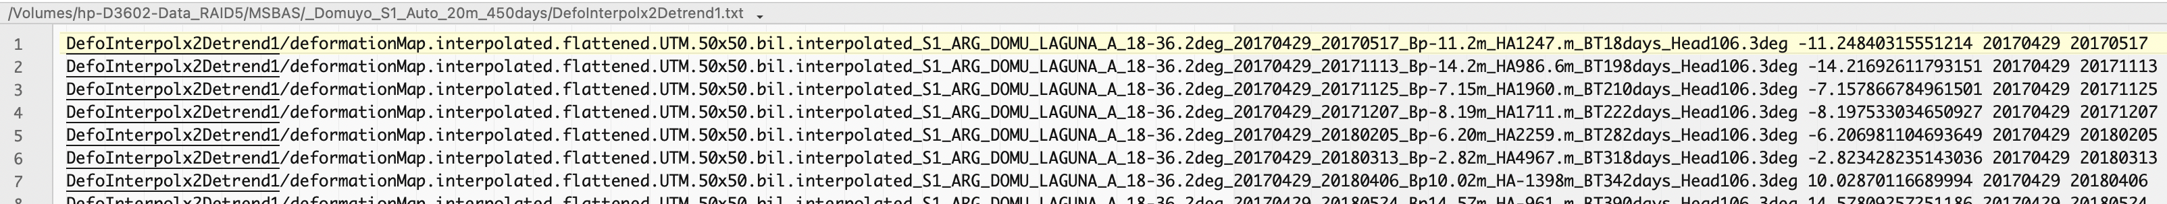
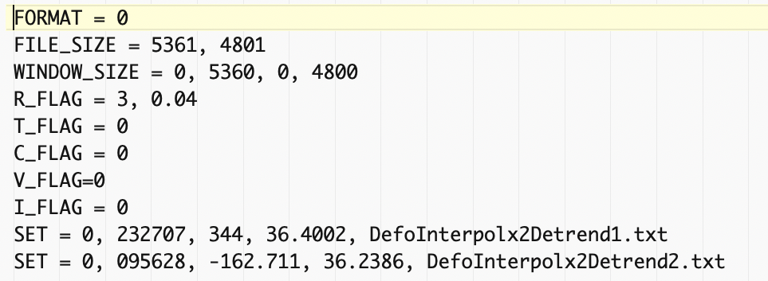
MSBAS & Exercise 3
Preparing the msbas inversion:
build_header_msbas_criteria.sh
First step consist in preparing the required files for MSBAS, that is
A directory where to run the inversion, e.g. $3602/MSBAS/YourRegion_and_Some_Info
A directory containing the (links to the) deformation maps for each mode to invert, e.g. $3602/MSBAS/YourRegion_and_Some_Info/DefoInterpolx2Detrendi
A file listing the deformation maps for each mode to invert along with some info, e.g. $3602/MSBAS/YourRegion_and_Some_Info/DefoInterpolx2Detrendi.txt
A header file containing the description of the data sets and the chosen parameters for the inversion

Slide 6
MSBAS & Exercise 3
Preparing the msbas inversion:
build_header_msbas_criteria.sh
To prepare these required files for MSBAS:
Create and go into a directory where to run the msbas $3602/MSBAS/YourRegion_and_Some_Info Here, do e.g.: mkdir $3602/MSBAS/_Argentina_S1_20m_450days_NoOptim
cd $3602/MSBAS/_Argentina_S1_20m_450days_NoOptim
Run the build_header_msbas_criteria.sh script with the followng parameters: - the name of the mode (eg. DefoInterpolx2Detrend) and the number of modes
- Max Bp and Bt to select the pairs to invert
- the path to where the mass processed are stored for each mode (e.g. where the Geocoded/ directory is), e.g. …$PATH_3601/SAR_MASSPROCESS/SAT/TRK/SMCrop_SM_ZOOM_ML/ Here, do e.g.: build_header_msbas_criteria.sh DefoInterpolx2Detrend 2 20 450 PATH_3601/SAR_MASSPROCESS/S1/ARG_DOMU_LAGUNA_A_18_SAMPLE/SMNoCrop_SM_20180512_Zoom1_ML4/ PATH_3601/SAR_MASSPROCESS/S1/ARG_DOMU_LAGUNA_D_83_SAMPLE/SMNoCrop_SM_20180222_Zoom1_ML4
Note that it must be run in the directory where msbas will be run.

Slide 7
MSBAS & Exercise 3
Preparing the msbas inversion:
build_header_msbas_criteria.sh
Warning: it will need to access the deformation maps which are stored in the provided path, that is e.g. …$PATH_3601/SAR_MASSPROCESS/SAT/TRK/SMCrop_SM_ZOOM_ML/Geocoded/DefoInterpolx2Detrend but also access to some info (baselines, acquisition time, azimuth, look angle…) that are in the pair directories, eg. …$PATH_3601/SAR_MASSPROCESS/SAT/TRK/SMCrop_SM_ZOOM_ML/MAS_SLV/i12/… However, if you have cleaned these pair directories to spare room on your disk, you can use the script build_header_msbas_criteria_From_nvi_name_WithoutAcqTime.sh It will get approximate information found in the deformation maps names. However, it will not find the acquisition time, which you will have to add manually in the header file (even a dummy time, that is OK). This script is however only for test purpose and may not be accurate !
Incremental: slower the first time, faster the next one…

Slide 8
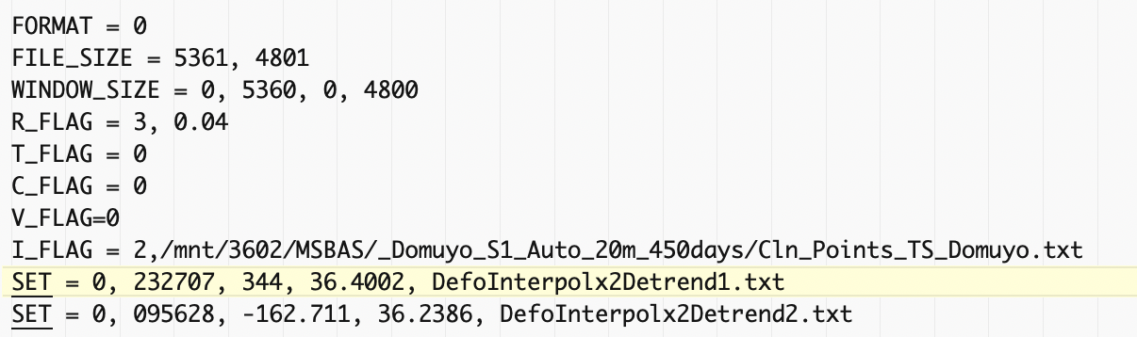
MSBAS & Exercise 3
Preparing the msbas inversion:
build_header_msbas_criteria.sh
The header.txt
Edit and change according to your needs (example below may differ from your data):
Possible crop
Inversion order and lambda factor
Reference
Time series
Set e.g. R_FLAG= 2, 0.04
I_FLAG = 0
Acq. Time
Data set
Azimuth heading
Incidence
look angle

Slide 9
MSBAS & Exercise 3
Preparing the msbas inversion
Running the msbas inversion:
MSBAS.sh
Run the MSBAS.sh script with the following parameters: - a description used for naming directories where results will be sorted (eg. _Order_Lambda_Info)
- a list of pixels for which you want to extract simple time series (with error bar) Here, do e.g.: MSBAS.sh _2_0.04_NoCrop
It will run in parallel with all the available CPUs
In case of crash:
Check DefoInterpolx2Detrendi.txt for bad links or duplicated lines: _Check_bad_DefoInterpolx2Detrend.sh
Check the baseline plot: PlotBaselineGeocMSBASmodeTXT.sh
Check non empty deformation in given zone: Check_Interfero_Not_Empty_In_Zone.sh
Check and remove broken links: Remove_BrokenLinks_and_Clean_txt_file.sh
Check that you have enough RAM; crop if needed
If complains about KMLSUPEROVERLAY (only needed to create kml file), check gdal
…

Slide 10
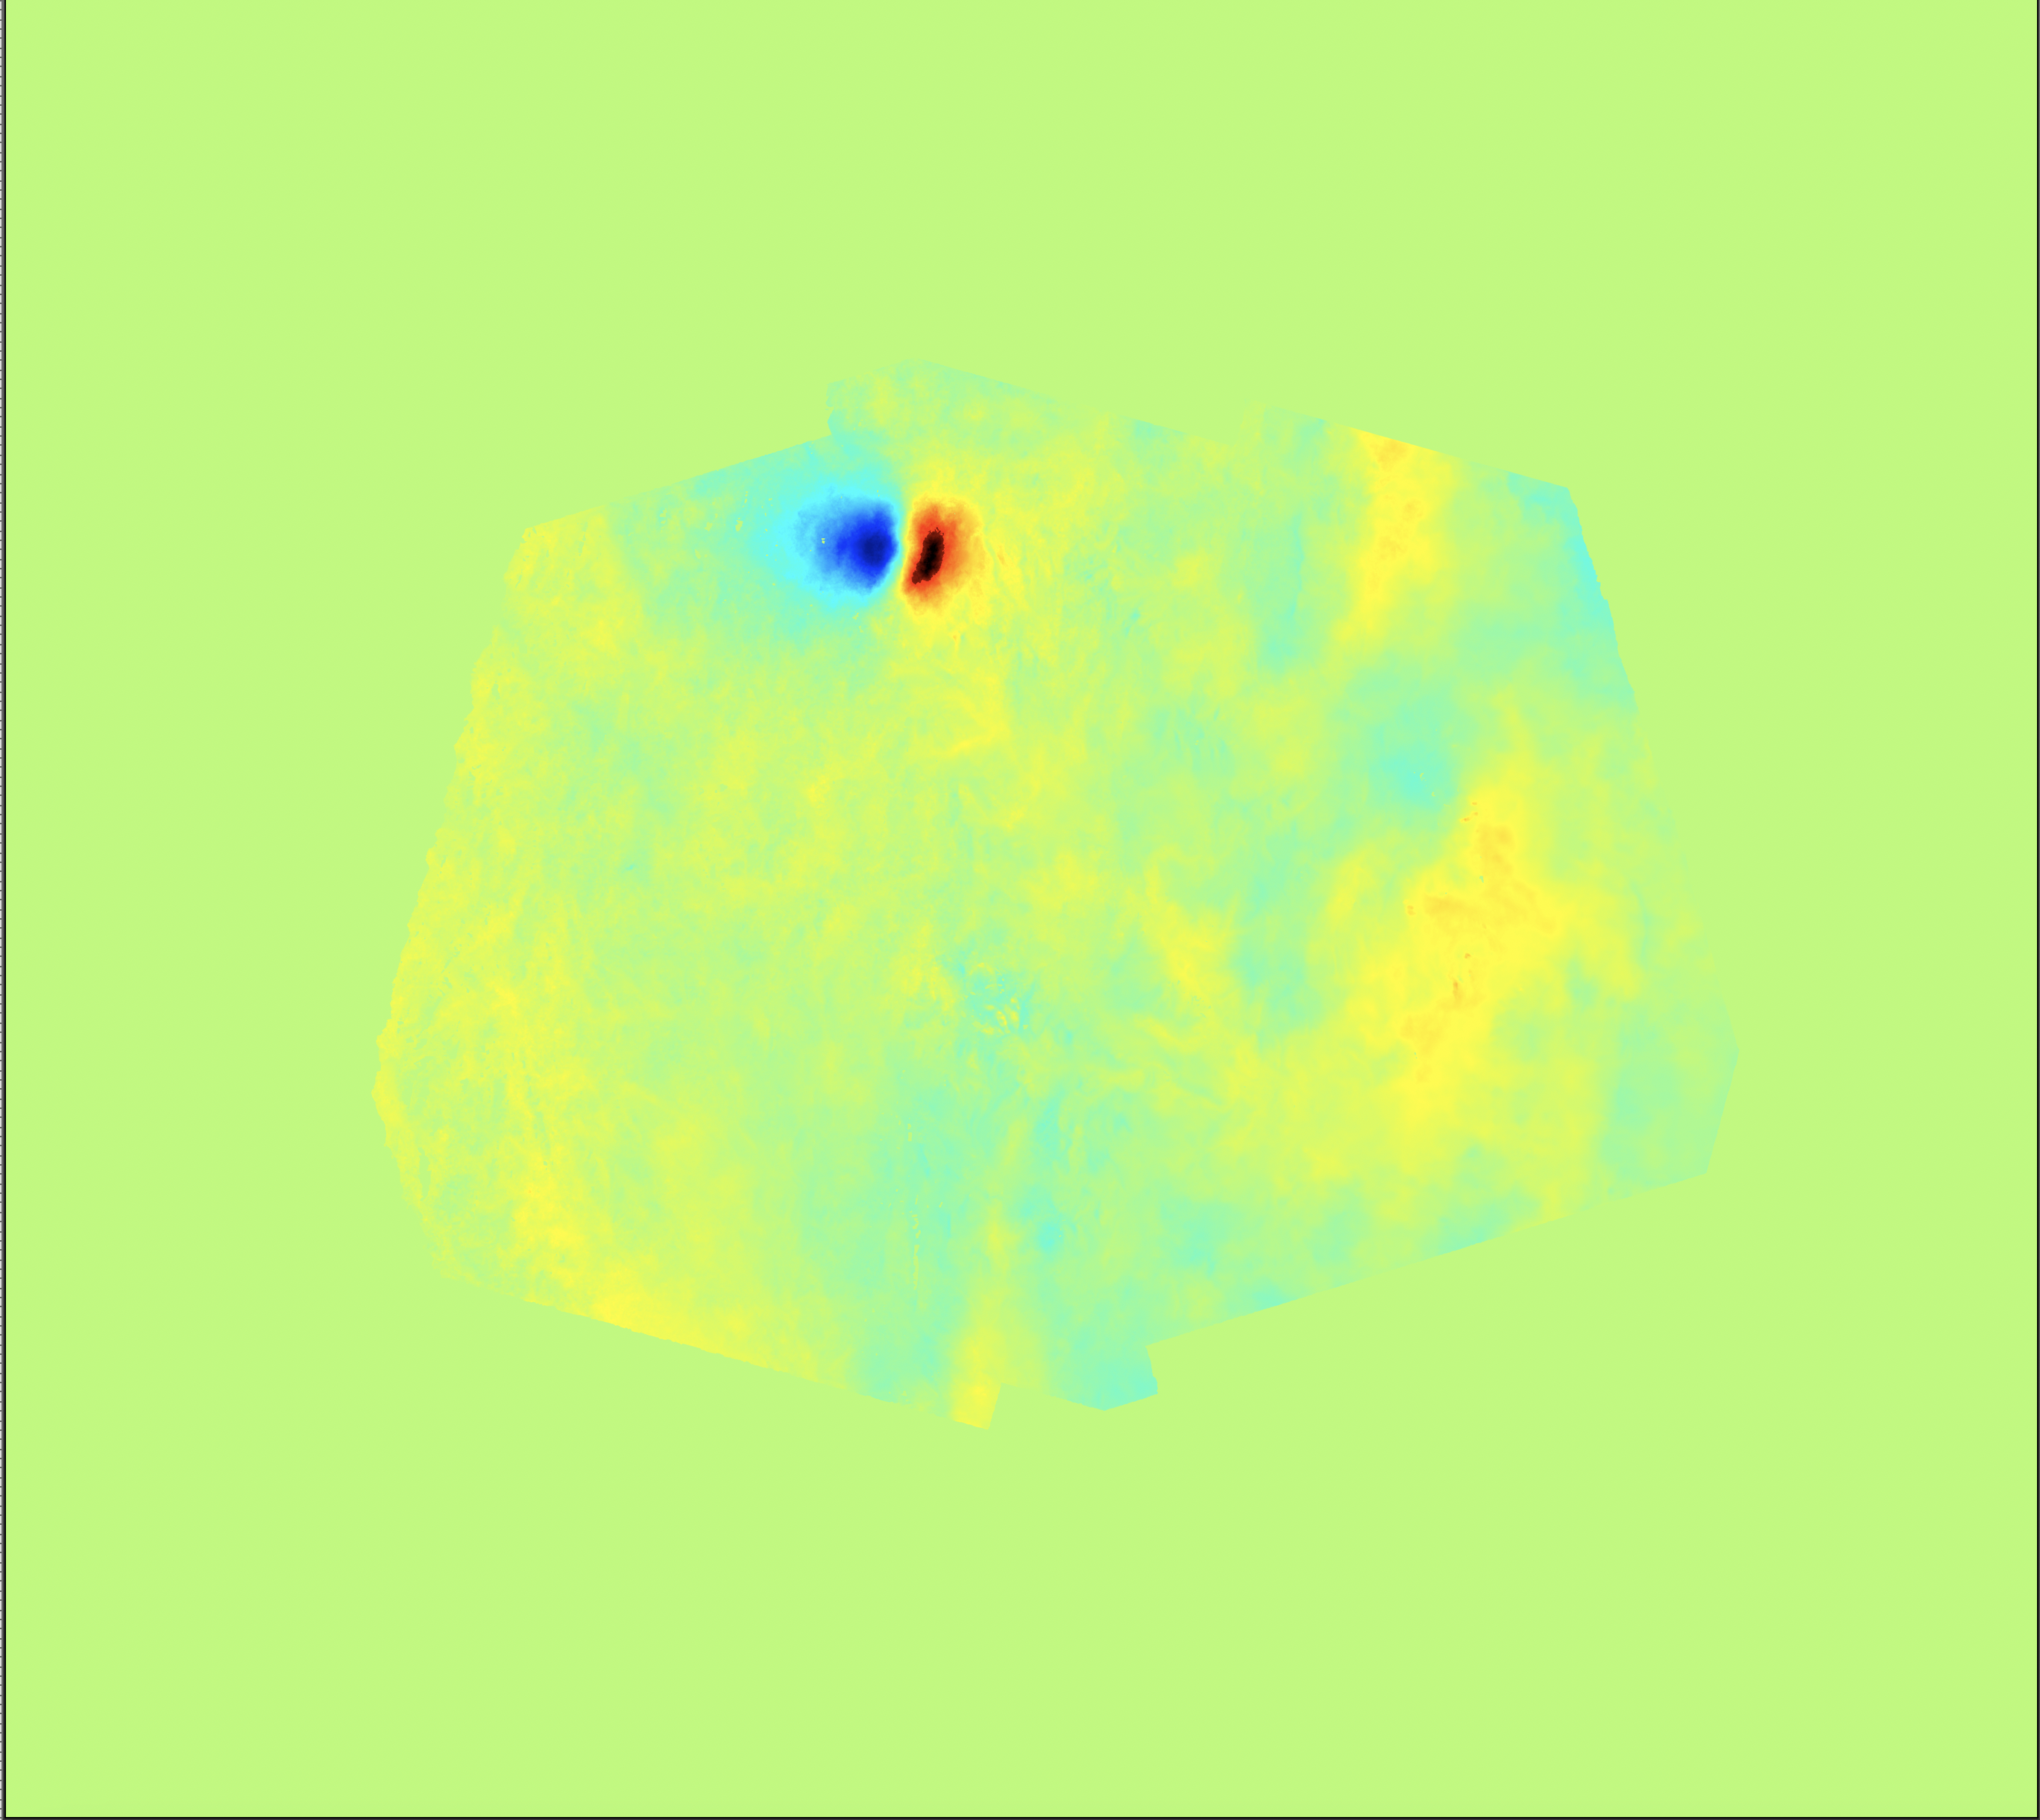
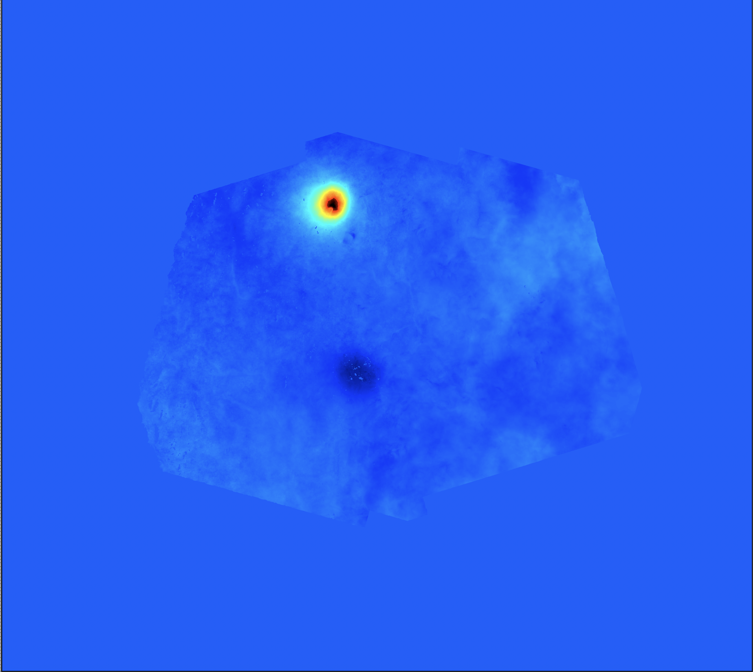
MSBAS & Exercise 3
Preparing the msbas inversion
Running the msbas inversion:
MSBAS.sh
Results:
EW linear rate
UD linear rate
…/3602/MSBAS/_Argentina_S1_20m_450days_NoOptim/zz_Comp_2_0.04_NoCrop

Slide 11
MSBAS & Exercise 3
Preparing the msbas inversion
Running the msbas inversion:
MSBAS.sh
SBAS, MSBAS 2D, MSBAS 3D
If enough looking angle diversity is provided, msbas will perform a 2D decomposition.
If only one mode is provided, or if similar incidence angles, it will perform a (mean) SBAS inversion
To perform 3D inversion when movement is supposed to take place of the steepest slope, one needs additional constrains (i.e. gradient). See MSBASv10_notheory_processing_manual_Sergey.pdf Change header file and add required files accordingly Scripts are under development for that 3D application
(filtering of DEM must be fine tuned; See Add_NS_comp_msbas.sh ). ➔ commin soon…

Slide 12
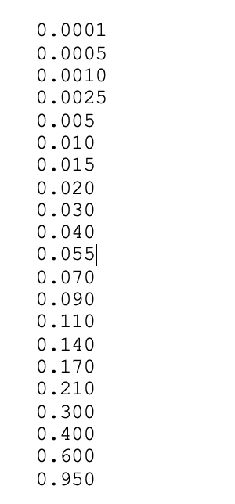
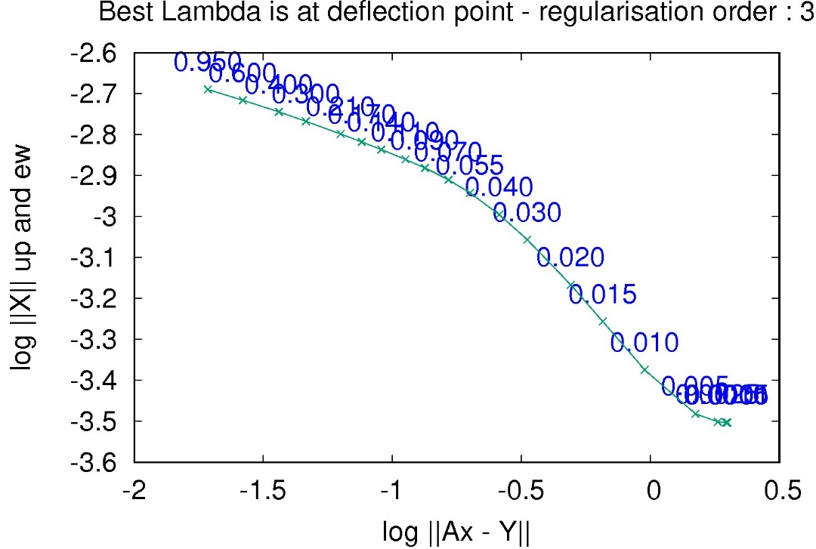
MSBAS & Exercise 3
Preparing the msbas inversion
Running the msbas inversion
Selecting the best inversion parameters:
test_lcurve.sh
Search for best lambda factor for each regularisation order.
Based on a table of steps of lambda Steps_LCurve.txt (in SCRIPTS_MT) for which it will run each time an msbas inversion (➔ time consuming !)
Output l-curves where the kink in the curve points to the best lambda factor. Larger value will lead to stronger smoothing.

Slide 13
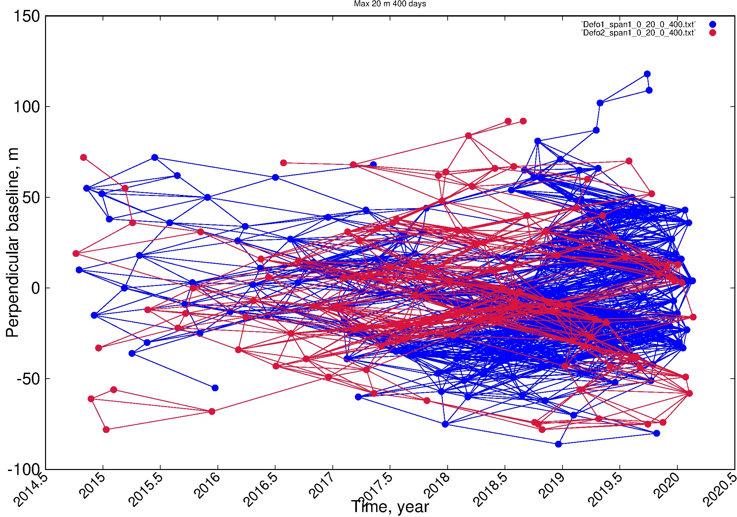
MSBAS & Exercise 3
Preparing the msbas inversion
Running the msbas inversion
Selecting the best inversion parameters
Additional pairs selection:
Coherence threshold
If the selectedd temporal baseline is long enough to keep coherent pairs from summer to summer, it may happen that, in the mean time, the winter would cause decorrelation between summer and winter time:
Max Btemp
Studies have shown that it could lead to severe signal underestimation (Smittarello et al. 2022) !

Slide 14
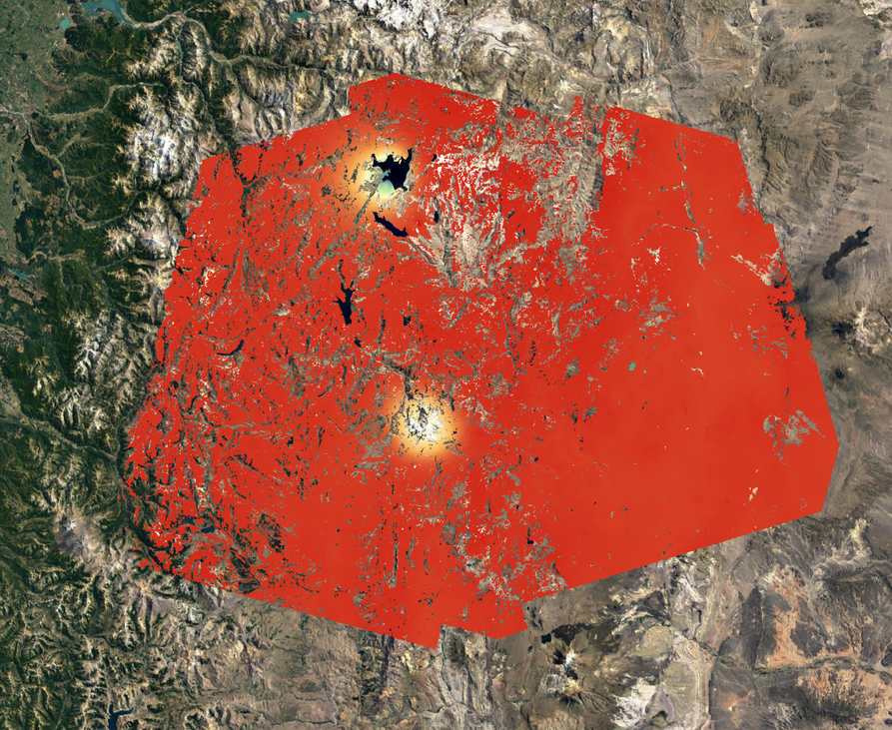
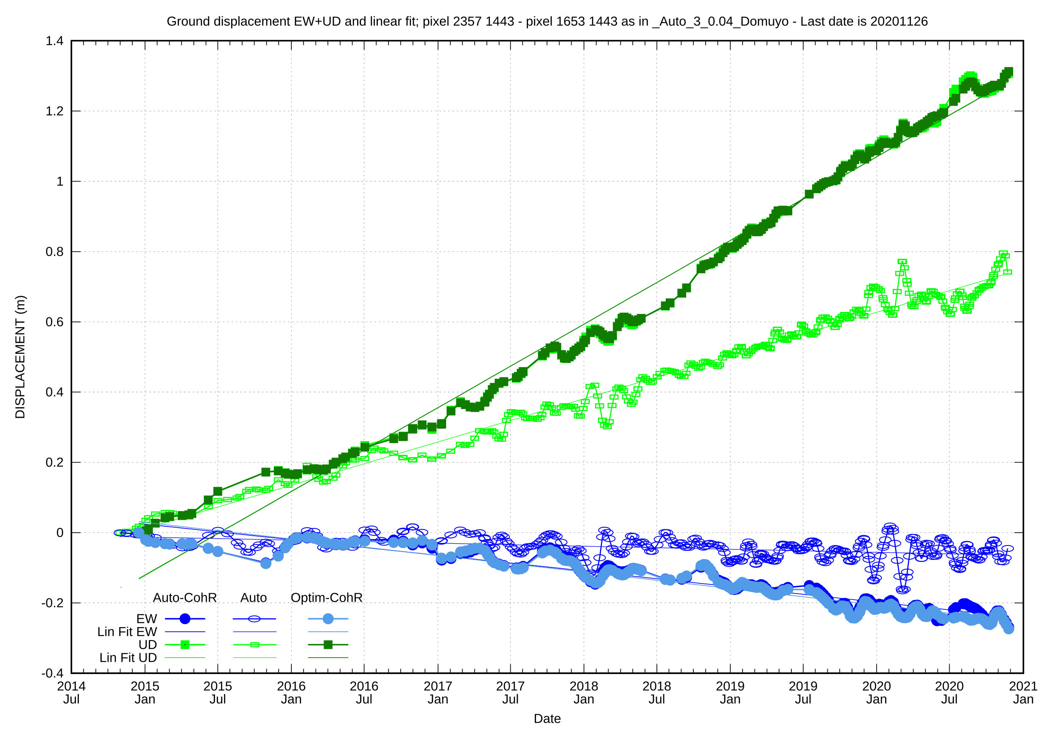
MSBAS & Exercise 3
2014-2020: Sentinel 1:
- Full: 2666 interferograms
- With Coh Threshold: 1013
- Optimized => -75 %
Laguna del Maule
(Smittarello et al. 2022)
With Coh Thresh. (& optim.)
Domuyo
Without Coh Thresh.
25.000 km² ; 50m resolution
Bp=20 m ; Bt=450 days

Slide 15
MSBAS & Exercise 3
Preparing the msbas inversion
Running the msbas inversion
Selecting the best inversion parameters
Additional pairs selection:
Coherence threshold
Use the script restrict_msbas_to_Coh.sh with the following parameters: - Mode to clean, eg. DefoInterpolx2Detrendi - a coherence threshold - the path to a kml where mean coherence must be computed - the path to the directory where the geocoded coherence maps are stored, e.g SAR_MASSPROCESS/SAT/TRK/REGION_ML/Geocoded/Coh
=> it creates the necessary files in …/MSBAS_RESULTS/LOCATION/MODEi
Use the script Exclude_Pairs_From_Mode.txt.sh with the following parameter: $3602/MSBAS/YourRegion_and_Some_Info/DefoInterpolx2Detrendi
Execute MSBAS.sh as before (provides a meaningful text string for directory naming)
Note: Coherence threshold selection is incremental ➔ slower the first time, faster the next ones…

Slide 16
MSBAS & Exercise 3
Preparing the msbas inversion
Running the msbas inversion
Selecting the best inversion parameters
Additional pairs selection:
Coherence threshold
Start – stop dates
To restrict the computation of MSBAS to images acquired before or after a given date, use the scripts:
RemovePairsFromFlist_WithImagesAfter.sh
RemovePairsFromFlist_WithImagesBefore.sh
Similarily, to restrict the computation of MSBAS to images acquired between or without images acquired between a given pair of dates, use the scripts:
RemovePairsFromTableList_Between_dates.sh
RemovePairsFromTableList_Outside_dates.sh
We will see later how we can plot ground deformation times series (from msbas results) for given pixels. These plots of time series can also be restricted to given dates, but that is not the same ! Here we restrict the inversion.

Slide 17
MSBAS & Exercise 3
Preparing the msbas inversion
Running the msbas inversion
Selecting the best inversion parameters
Additional pairs selection:
Coherence threshold
Start – stop dates
Optimisation (cfr Delphine Smitarello’s ppt) or restrict pair selection to Max 3 times
See 6_AMSTer_Optimisation.pptx for optimisation based on Coherence or Coherence proxy etc..
To restrict the computation of MSBAS to images taken max 3 times as Master and 3 times as Slave, run these scripts (see manual or scripts):
Extract_Baselines_3.sh
Keep_Pairs_From_Extract_Baseline_3.sh

Slide 18
MSBAS & Exercise 3
Preparing the msbas inversion
Running the msbas inversion
Selecting the best inversion parameters
Additional pairs selection:
Coherence threshold
Start – stop dates
Optimisation (cfr Delphine Smitarello’s ppt) or Max 3 times
Phase closure
To search for possible interferograms affected by unwrapping error by checking phase closure consistency between triangles of pairs, run the following scripts:
Extract_Triangles.sh to list all the triangles from the list of pairs (eg $PATH_1650/SAR_SM/MSBAS/Region/seti/table_0_MaxBp_0_MaxBt.txt) saved in a file _Triangles/List_Triangels.txt.
Check_Closure_All_Triangles.sh to check unwrapping error in all triangles. It computes the mean phase based on a kml provided as parameter and consider that there is or there is no phase closure error based on an offset provided also as a parameter. It outputs 3 files in …/SAR_MASSPROCESS/SAT/TRK/REGION_ML/Geocoded/_CheckTriangles.txt/: _Good_Closure.txt, _Wrong_Closure.txt and _Pairs_To_Clean_From_WrongClosure_NotIn_GoodClosure.txt
Wrong pairs in _Pairs_To_Clean_From_WrongClosure_NotIn_GoodClosure.txt can be rejected from MSBAS by running Remove_Pairs_From_BaselineOptimisation.sh

Slide 19
MSBAS & Exercise 3
To test phase closure with Argentine dataset (beware: need Check_Closure_All_Triangles.sh > V1.4):
Extract_Triangles.sh $PATH_1650/SAR_SM/MSBAS/ARGENTINE/set1/table_0_20_0_450.tx lists all triangles in $PATH_1650/SAR_SM/MSBAS/ARGENTINE/set1/_Triangles/List_Triangles.txt i.e. including those for which you do not have pair directories in SAR_MASSPROCESS ➔ make artificial list with only 2022 and 2023 pairs, eg. grep 2022 List_Triangles.txt > List_Triangles_2022-2023.txt grep 2023 List_Triangles.txt >> List_Triangles_2022-2023.txt grep –v 2021 List_Triangles_2022-2023.txt > List_Triangles_2022-2023-no2020.txt (maybe also without 2020..)
Check_Closure_All_Triangles.sh $PATH_1650/SAR_SM/MSBAS/ARGENTINE/set1/_Triangles/List_Triangles_2022-2023-no2020.txt $PATH_3601/SAR_MASSPROCESS/S1/ARG_DOMU_LAGUNA_A_18_SAMPLE/SMNoCrop_SM20180512_Zoom1_ML4/Geocoded/DefoInterpolx2Detrend $PATH_1650/kml/ARGENTINA/LagunaDelMaule_TestPhaseClosure.kml 0.9 lists $PATH_3601/SAR_MASSPROCESS/SAT/TRK/REGION_ML/Geocoded/_CheckTriangles.txt/_Good_Closure.txt and $PATH_3601/SAR_MASSPROCESS/SAT/TRK/REGION_ML/Geocoded/_CheckTriangles.txt/_Wrong_Closure.txt and $PATH_3601/SAR_MASSPROCESS/SAT/TRK/REGION_ML/Geocoded/_CheckTriangles.txt/_Pairs_To_Clean_From_WrongClosure_NotIn_GoodClosure.txt (and ignore the triangles for which there is no pair directories in SAR_MASSPROCESS)
Wrong pairs in _Pairs_To_Clean_From_WrongClosure_NotIn_GoodClosure.txt can be rejected from MSBAS by running Remove_Pairs_From_BaselineOptimisation.sh $PATH_3602/MSBAS/_Argentina_S1_20m_450days/DefoInterpolx2Detrend1 $PATH_3601/SAR_MASSPROCESS/SAT/TRK/REGION_ML/Geocoded/_CheckTriangles.txt/_Pairs_To_Clean_From_WrongClosure_NotIn_GoodClosure.txt
Do the same for DefoInterpolx2Detrend2 if required
Run again MSBAS.sh after having renamed the DefoInterpolx2Detrendi_Optimized__Pairs_To_CleanPFrom…..txt as DefoInterpolx2Derendi.txt

Slide 20
MSBAS & Exercise 3
Plan:
Preparing the msbas inversion:
build_header_msbas_criteria.sh
The header.txt
Running the msbas inversion:
MSBAS.sh
SBAS, MSBAS 2D, MSBAS 3D
Selecting the best inversion parameters:
test_lcurve.sh
Additional pairs selection:
Coherence threshold
Start – stop dates
Optimisation (cfr Delphine Smitarello’s ppt) or Max 3 times
Phase closure
- DONE ! -

Slide 21

MasTer Toolbox
Sat. image
Download
Web Page(s)
Interferometric processing
(AMSTer Engine)
Ampli.
Coh.
Time Series processing
(MSBAS)
Ampli.
Defo.
Mean Veloc.
Amplitude Time Series processing
Interf.
Cumul. defo.
Defo.
Time series
G. Celli
D. Derauw
S. Samsonov
M. Jaspard
N. d’Oreye & D. Smittarello

